Slide 1
Unit 4 Lesson 1 - Set Up

Slide 2
Unit 4 Lesson 1 - Set Up

Slide 3
Unit 4 - Lesson 1
Variables Explore

Slide 5
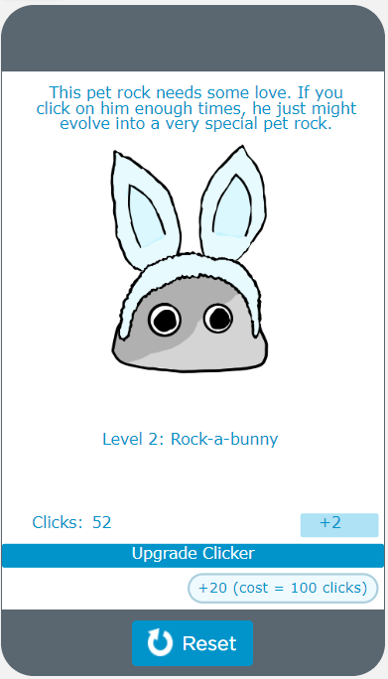
Unit 4 Lesson 1 - Warm Up
Do This:
Navigate to Lesson 1, Level 1 on Code Studio

Slide 6
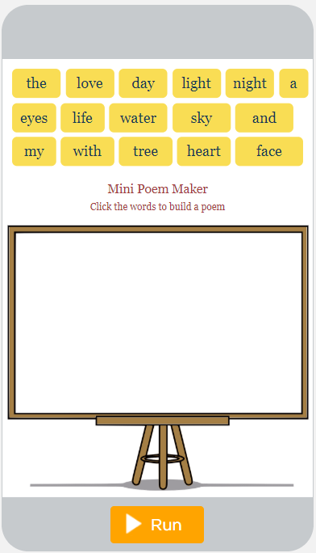
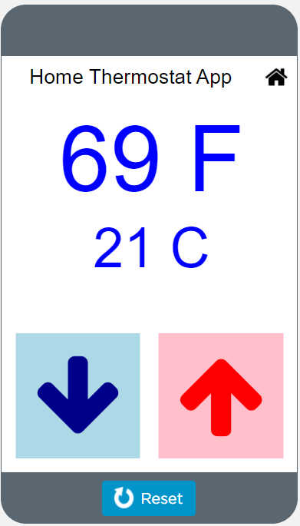
Unit 4 Lesson 1 - Warm Up
Prompt:
These are samples of the kinds of apps you'll be able to build by the end of this unit. As you go through them, write down at least two examples where the app seems to be keeping track of a piece of information or using it to make a decision.

Slide 8
Unit 4 Lesson 1 - Activity
Variables Explore
You and your partner should have:
Small stacks of red and yellow stickies
3 plastic baggies
Pen/Pencil
Dry erase marker
MARKER

Slide 9
Unit 4 Lesson 1 - Activity
Value
One piece of information
Goes on a sticky
Do This:
Make one number and one string. Share it at your table.
Numbers
Made of the digits 0...9
No quotes
Yellow sticky
Strings
Made of any characters
Inside double quotes
Red sticky
“hi”
22
9
“hi there”
548
123
“c u l8r”
“123”

Slide 10
Unit 4 Lesson 1 - Activity
Operators
Fancy name for + - * /
2
3
5
+
evaluates to
Expression
Combination of operators and values
Evaluates to single value
Do This: Evaluate this expression
5
-
1

Slide 11
Unit 4 Lesson 1 - Activity
3
+
4
7
Do This: Evaluate these expressions. Pay attention to what color stickies you create and if you use quotes.
evaluates to
5
-
2
evaluates to
3
4
+
5
9
11
*
2
evaluates to
22
10
-
9
1
10
/
2
evaluates to
5
“tree”
+
“house”
"treehouse"
“for”
+
“ever”
evaluates to
“forever”
“gr”
+
8
“gr8”
“you”
+
“r”
“your”
evaluates to
2
+
“day”
“2day”
3
+
“D”
“3D”
evaluates to
If you’re using one or two strings, you can only use the + operator. The others don’t make sense!

Slide 12
Unit 4 Lesson 1 - Activity
Variables
Plastic baggies
Can hold at most one value
Name uses no quotes, includes no spaces, and must start with a letter
Do This:
Make one variable with any name you like. Share it with another group.
zip2
zip
2
woop
“hi”

Slide 13
Unit 4 Lesson 1 - Activity
Variables and Expressions
Replace variable name with a copy of the value it holds
Evaluate the expression as normal
Make a copy of the value in zip. Don’t take the sticky out of zip.
3
+ zip
zip
5
3
5
evaluates to
8
bop + zip
bop
“hi”
“hi”
5
“hi5”
evaluates to

Slide 14
Unit 4 Lesson 1 - Activity
Do This: Evaluate these expressions. Make sure you pay attention to whether it evaluates to a string or a number.
3
* boo
12
boo
4
rar +
“ep”
“beep”
rar
“be”
rar + boo
“be4”

Slide 15
Unit 4 Lesson 1 - Activity
Let’s start writing programs that control our variables.
We’re going to stop using stickies but will highlight strings and numbers to help you remember the difference.

Slide 16
Unit 4 Lesson 1 - Activity
var
Creates a new variable
Grab a new baggie
Write the variable’s name on the baggie
00 var pow
pow
Line number
Command to create variable
Variable’s name

Slide 17
Unit 4 Lesson 1 - Activity
←
“Assignment operator”
“Assign”: a fancy name for putting a value inside the baggie.
Variables can only hold one stickie. If there’s already a sticky note in there, throw it away.
“pow gets 3” and “pow gets 5”
Do This: Run this program
pow
00 var pow
01 pow ← 3
02 pow ← 5
pow
3
pow
3
5

Slide 18
Unit 4 Lesson 1 - Activity
Do This:
Run this program. Compare your result with another group.
00 var pizza
01 pizza ← 3
02 var tacos
03 pizza ← “yum”
04 tacos ← “the best”
pizza
“yum”
tacos
“the best”

Slide 19
Unit 4 Lesson 1 - Activity
Assign a Variable with Expression
Evaluate the expression first to get one value.
Assign the value as normal
pow
00 var pow
01 pow ← 1 + 2
02 pow ← 3 + 4
pow
3
Evaluate expression first
pow
3
7

Slide 20
Unit 4 Lesson 1 - Activity
Do This:
Run this program. Compare your result with another group.
00 var zow
01 var fly
02 fly ← “to” + “day”
03 zow ← 4 - 1
04 fly ← 3 * 3
05 zow ← 4 + “now”
zow
“4now”
fly
9

Slide 21
Unit 4 Lesson 1 - Activity
We’re not going to highlight our strings and numbers anymore. We can just use double quotes around the strings to tell the difference.

Slide 22
Unit 4 Lesson 1 - Activity
Assign a Variable: Expressions with Variables
Evaluate the expression on the right first to get one value.
Assign the value as normal
kit
00 var kit
01 kit ← 1
02 var boo
03 boo ← kit + 1
04 kit ← 5
kit
1
kit
boo
1
kit
boo
1
2
1
Note: Variables aren’t “connected”. Changing kit doesn’t change boo.
kit
boo
5
2

Slide 23
Unit 4 Lesson 1 - Activity
Do This:
Run this program. Compare your result with another group.
00 var fuzz
01 var clip
02 fuzz ← 5
03 clip ← fuzz + 2
04 fuzz ← clip + 1
05 clip ← “gr” + fuzz
06 fuzz ← fuzz + 1
07 fuzz ← fuzz + 1
08 fuzz ← fuzz + 1
fuzz
11
clip
"gr8"

Slide 24
Unit 4 Lesson 1 - Activity
Key Takeaways
Numbers and strings are two different types of values
Expressions evaluate to a single new value
When variables are in the expression just make a copy, don’t change the actual variable.
Variables are “assigned” a new value
Evaluate first, then assign
Old values are deleted forever.
Assignment just moves information around. It does not “connect” variables.
22
“hi”
10
/
2
5
evaluates to
pow
00 var pow
01 pow ← 1 + 2
02 pow ← 3 + 4
pow
3
pow
3
7
Notes:
Review these key takeaways with students.

Slide 25
Unit 4 Lesson 1 - Activity
In some languages (including Javascript) the assignment operator is not written
←
it is written as
=

Slide 26
Unit 4 Lesson 1 - Activity
So the command
fuzz ← fuzz + 1
it is written as
fuzz = fuzz + 1
In math = means “are equal forever”
In programming = means “put this value in this variable”
We’ll see this more next time.

Slide 28
Unit 4 Lesson 1 - Wrap Up
Expression: a combination of operators and values that evaluates to a single value
Variable: holds one value at a time
Assignment Operator: allows a program to change the value represented by a variable
01 pow ← 1 + 2
pow
3
← OR =

Slide 30
Unit 4 Lesson 2 - Set Up

Slide 31
Unit 4 - Lesson 2
Variables Investigate

Slide 33
Unit 4 Lesson 2 - Warm Up
Prompt:
Let's do a quick review.
How does a baggy represent a variable?
pow
3

Slide 35
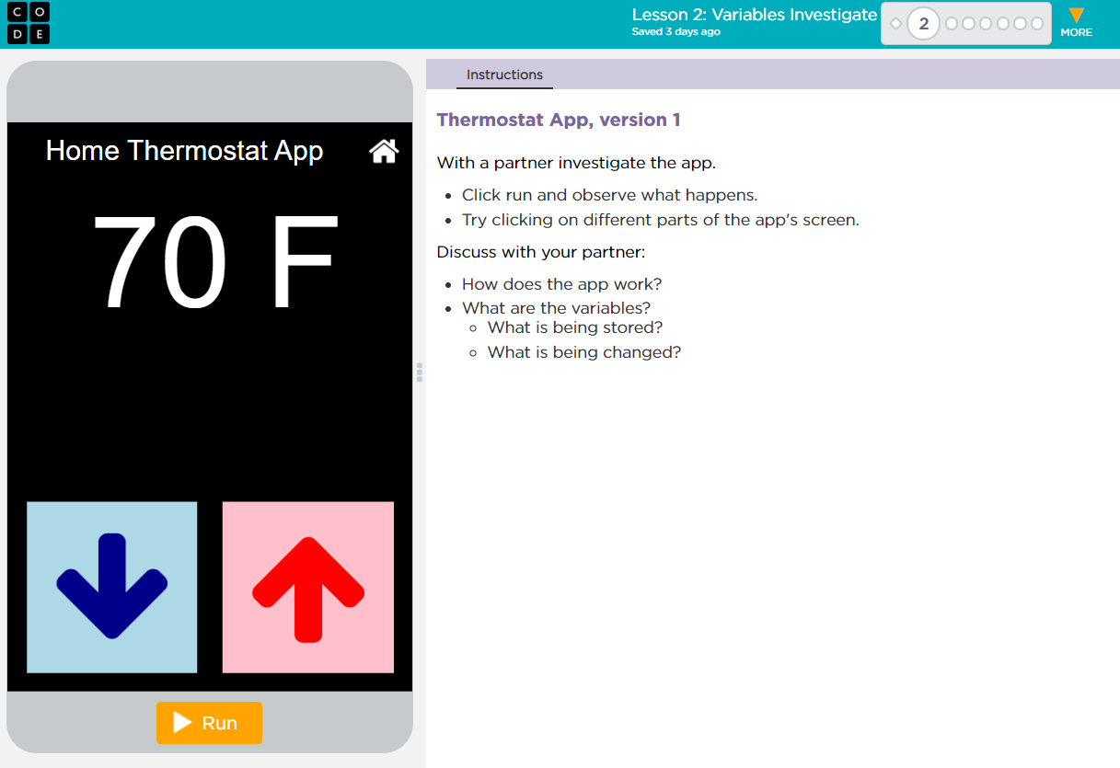
Unit 4 Lesson 2 - Activity
Variables Investigate

Slide 36
Unit 4 Lesson 2 - Activity
Level 1
Do This:
Run the app
Predict the information that is being stored in variables

Slide 37
Unit 4 Lesson 2 - Activity
Level 2
Do This:
Read Code: Read the code for your assigned section making sure you understand how it works.
Explain Your Section: Make a group with partners who investigated the other section. Carefully explain how your section works line by line.

Slide 38
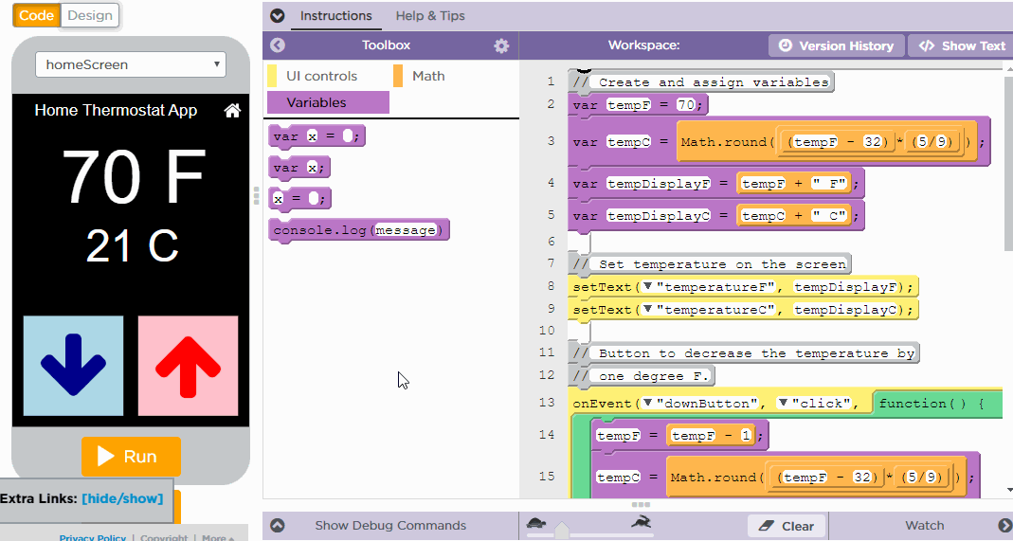
Unit 4 Lesson 2 - Activity
Adding a Watcher

Slide 39
Unit 4 Lesson 2 - Activity
Level 2
Do This:
Modify: Change the degrees by two when the up and down arrow are clicked.

Slide 40
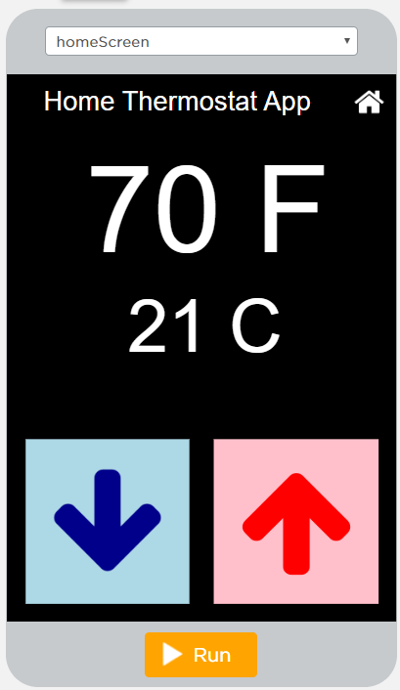
Unit 4 Lesson 2 - Activity
Level 3
Do This:
Run the app.
Discuss changes.
Find the Math.round command. Discuss with a partner how this command might work.
Modify: Change the code so that no space displays between the temperature and the unit descriptions ("F" or "C").

Slide 41
Unit 4 Lesson 2 - Activity
Level 4
Do This:
Run the app
Predict the information that is being stored in variables

Slide 42
Unit 4 Lesson 2 - Activity
Level 5
Do This:
Read Code: Read the code and discuss with your partner what has changed and what has stayed the same.
Class Discussion: How does getText() work?
Modify: Add an explanation point "!" to the end of the string stored in userName so the following is displayed on the screen:

Slide 43
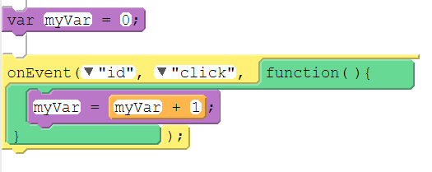
Unit 4 Lesson 2 - Activity
Counter Pattern with Event
Name | Code (Block) | Code (Text)
Counter Pattern with Event |  | var myVar = 0; onEvent("id", "click", function() { myVar = myVar + 1; });

Slide 44
Unit 4 Lesson 2 - Activity
Variable with String Concatenation
Name | Code (Block) | Code (Text)
Variable with String Concatenation |  | var myString = "rock"; var myOtherString = "roll"; var myStory = myString + " and " + myOtherString;

Slide 46
Unit 4 Lesson 2 - Wrap Up
Prompt:
Let's review. What can be stored in a variable? Why is using a meaningful name for the variable important?

Slide 47
Unit 4 Lesson 2 - Wrap Up
Variable: a reference to a value or expression that can be used repeatedly throughout a program.

Slide 49
Unit 4 Lesson 3 - Set Up

Slide 50
Unit 4 - Lesson 3
Variables Practice

Slide 53
Unit 4 Lesson 3 - Activity
Debugging: the process of finding and fixing problems in code
Describe The Problem What do you expect it to do? What does it actually do? Does it always happen? | Hunt For Bugs Are there warnings or errors? What did you change most recently? Explain your code to someone else Look for code related to the problem
Try Solutions Make a small change | Document As You Go What have you learned? What strategies did you use? What questions do you have?

Slide 54
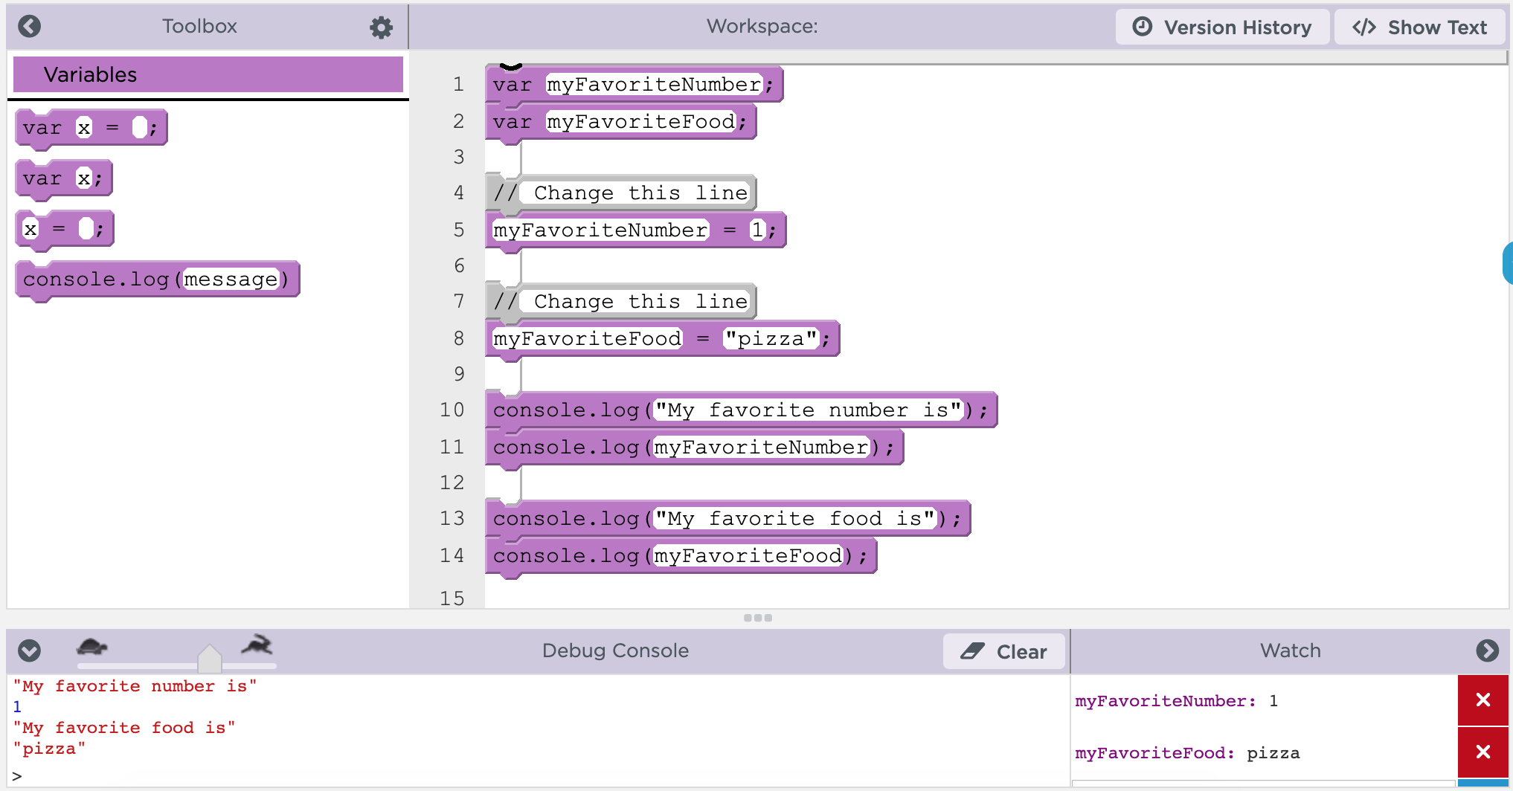
Unit 4 Lesson 3 - Activity
Specific Debugging Skills for the Day
1. Slow down code with the speed slider
2. Use console.log to get output
3. Use Watchers to see your variables change values

Slide 55
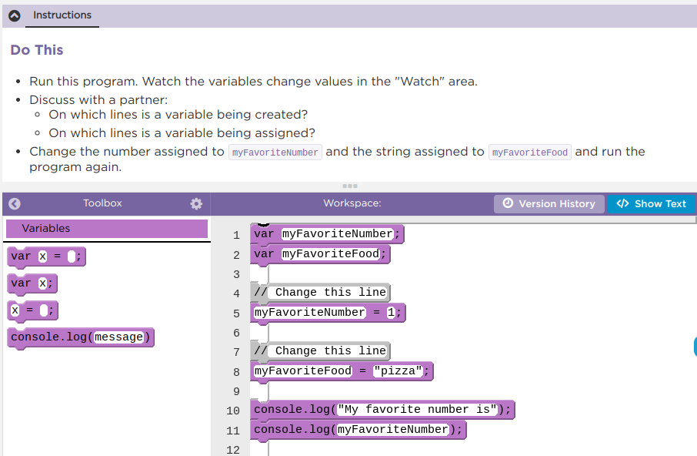
Unit 4 Lesson 3 - Activity
Variables Practice
Do This:
Navigate to Lesson 3, Level 1 on Code Studio
Complete Levels 1-7

Slide 56
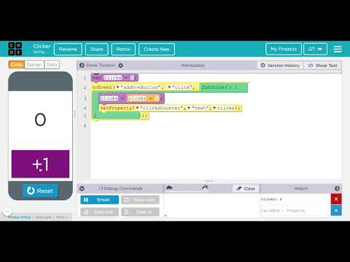
Unit 4 Lesson 3 - Activity
Video Download Link

Slide 57
Unit 4 Lesson 3 - Activity
Create Variables Once, At the Top, Outside Functions or onEvent()
When you create variables you should:
Use var only once. You don't need to create variables twice and this can cause errors.
Create your variables at the top of your program. This keeps your code organized and easier to read for you and others.
Create your variables outside any function or onEvent() bocks.

Slide 58
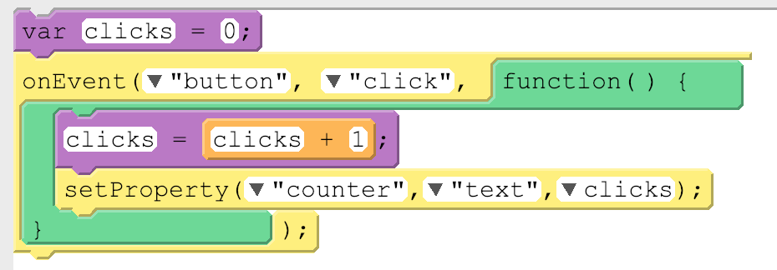
Unit 4 Lesson 3 - Activity
Global vs. Local Variables
There's two types of variables, global and local, and so far we've only used global variables. Here's the main difference between global and local variables.
Type of Variable | How It Works | How Created | Picture
Global | Permanent. Can be used anywhere in your code. | var used outside an onEvent()
Local | Temporary. Can be used only in the part of the code where it was created, like inside an onEvent(). Deleted once the onEvent() is done running. | var used inside an onEvent()

Slide 59
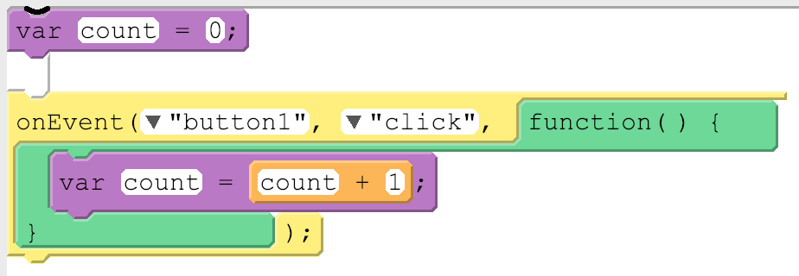
Unit 4 Lesson 3 - Activity
Avoiding Local Variables and Debugging
Local variables will eventually be useful but for now they're most likely to just be confusing. The biggest issue you'll run into right now with local variables is accidentally using var inside of an onEvent() or function. Here's what the code usually looks like:
This code is pretty confusing. While it looks like there's only one variable being used, it actually has two variables, one local and one global, and they're both named count! Changing the value on one will have no impact on the other. This can cause unexpected behavior in your code and it can get tricky to debug.
The best way to avoid these issues is to make sure for now that you're not using var inside of an onEvent() or function. If you run into a tricky debugging problem, check if you're accidentally creating a local variable.

Slide 60
Unit 4 Lesson 3 - Activity
Do This:
Review Lesson 8
Finish Levels 9-10

Slide 62
Unit 4 Lesson 3 - Wrap Up
Prompt:
What aspects of working with variables do you feel like clicked today? What do you still feel like you have trouble with?

Slide 64
Unit 4 Lesson 4 - Set Up

Slide 65
Unit 4 - Lesson 4
Variables Make

Slide 68
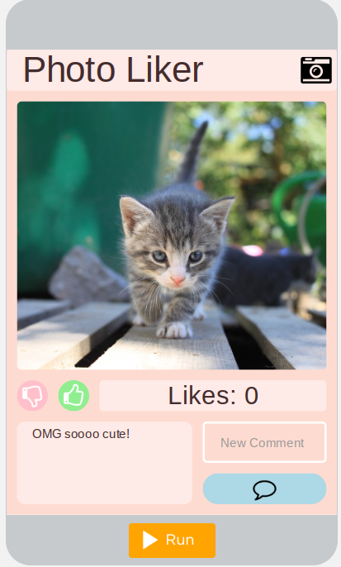
Unit 4 Lesson 4 - Activity
Variables Make:
Photo Liker
Do This:
Navigate to Lesson 4, Level 1 on Code Studio

Slide 69
Unit 4 Lesson 4 - Activity
Prompt: Try all of the buttons and add a comment to the picture
What does this app do?
What are the inputs?
What are the outputs?
What's one piece of information that might be stored in a variable?

Slide 70
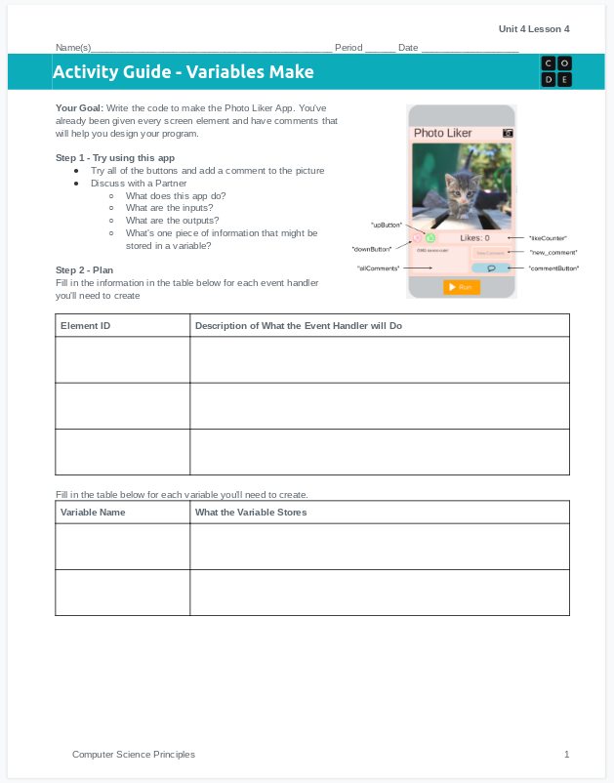
Unit 4 Lesson 11 - Activity
Do This: Make the Photo Liker!
Use the activity guide to plan out your code, including the event handlers and variables you'll need to create.
Step 3 includes steps you can follow to build the app, or you can use your own process.

Slide 71
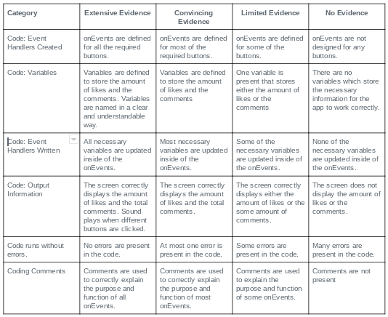
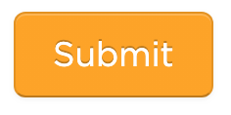
Unit 4 Lesson 11 - Activity
Don't forget to check the rubric before hitting submit!

Slide 73
Unit 4 Lesson 4 - Wrap Up
Great job today!

